Slide 1
Foundations of Materials Science and Engineering Fifth Edition William F. Smith Javad Hashemi
林樹均 sjlin@mx.nthu.edu.tw
材料科技館509辦公室 Tel: 03-5742620
助教：呂佩瑜 <peggy8306@gmail.com>; 張怡婷 <to889889@gmail.com>; 李承穎 <irislee0606@gmail.com>

Slide 2
一、課程說明(Course Description)
本課程提供一學期課程，使學生對材料科學有初步認識，並介紹最常用的金屬材料。
The purpose of this course is to provide first-year engineering students fundamental knowledge of materials science and engineering.
二、指定用書(Text Books)
William F. Smith, "Foundations of Materials Science and Engineering" 5th edition,
McGRAW-HILL INTERNATIONAL EDITIONS (2011). 高立圖書(gauli@ms37.hinet.net)代理，0921456030顏俊杰。新竹華通書局0939558750李鵬。

Slide 3
三、參考用書
劉國雄、鄭晃忠、李勝隆、林樹均、葉均蔚 編著，工程材料科學，全華圖書股份有限公司 印行，2013年。
四、教學方式(Teaching Method)
投影片配合板書
六、成績考核(Evaluation)
期中考一、期中考二、期末考各佔30%，作業10%，點名加分。
七、可連結之網頁位址
上課講義會放在計中iLMS。

Slide 4
五、教學進度(Syllabus)
1. Introduction 2 hours
2. Atomic Structure and Bonding 6 hours
3. Crystal Structure 5 hours
4. Solidification and Crystalline Imperfection 5 hours
Midterm Exam I 2 hours
5. Diffusion in Solids 4 hours
6. Mechanical Properties (I) 6 hours
7. Mechanical Properties (II) 4 hours
Midterm Exam II 2 hours
8. Phase Diagrams 5 hours
9. Engineering Alloys 9 hours
Final Exam 2 hours

Slide 5
CHAPTER 1
Introduction to
Materials Science
and
Engineering

Slide 6
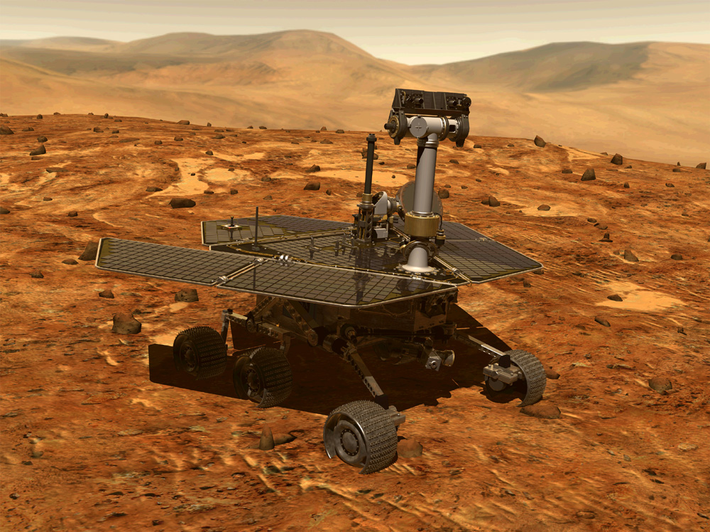
The Mars Rovers - Spirit and Opportunity
Spirit and Opportunity are made up of materials such as
* Metals * Ceramics * Composites * Polymers * Semiconductors
www.nasa.gov

Slide 7
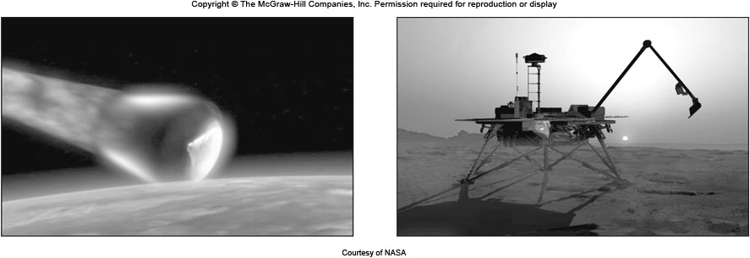
The Phoenix Mars Lander火星探測
火星探測漫遊者(MER)：精神號和機會號，前者2003年6月10日發射，2004年1月3日著陸火星表面，2011年3月22日最後一次聯絡上。後者2004年1月25日著陸，截至2014年7月28日里程數超過40公里，打破NASA在地球外的無人探測車移動記錄。
鳳凰號火星探測器：2007年8月4日發射，2008年5月25日成功著陸火星，目的是尋找火星北極土壤中可能存在的生命特徵，對淺層地下的水冰進行研究。
好奇號(Curiosity)： 2011年11月26日發射， 2012年8月6日著陸，探測火星氣候、地質、水，及研究日後人類探索的可行性。

Slide 8
The Phoenix Mars Lander
The major instruments aboard the Lander: a camera-enabled robotic arm, microscopy, electrochemistry, and conductivity analyzer, thermal and evolved gas analyzer, 氣體分析儀 various imaging systems, a meteorological station.氣象站
Materials challenges of extreme conditions: solar storm, micrometeorite impact, 微隕石 very high entry temperature (1700 °C), tremendous deceleration force, Martian cold temperature, −123 °C Martian dust storm. 火星塵暴

Slide 9
What are Materials?
Improvement of materials → Advancement of civilization Stone Age → Copper Age → Iron Age → Multiple Age
Webster’s dictionary: Materials may be defined as substance of which something is composed or made.
We obtain materials from earth crust and atmosphere.
Examples :
Silicon and Iron constitute 27.72 and 5.00 percentage of weight of earths crust respectively.
Nitrogen and Oxygen constitute 78.08 and 20.95 percentage of dry air by volume respectively.

Slide 10
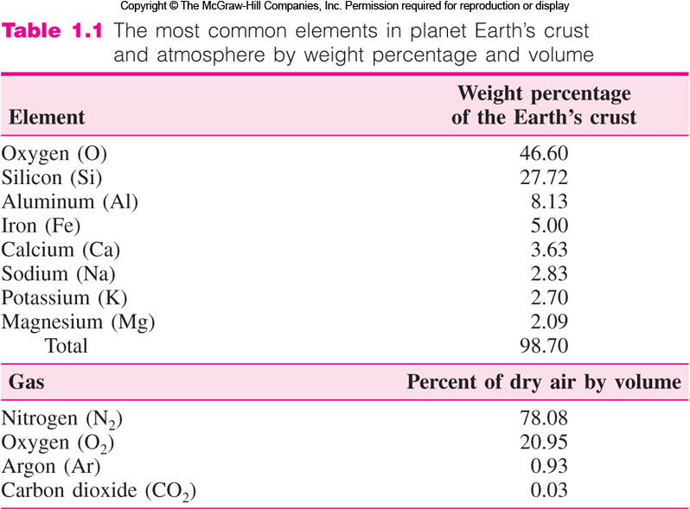

Slide 11
Why the Study of Materials is Important?
Production and processing of materials constitute a large part of our economy.
Engineers choose materials to suite design.
New materials might be needed for some new applications.
Example: High temperature resistant materials.
Space station and Mars Rovers should sustain conditions in space.
* High speed, low temperature, strong but light.
Modification of properties might be needed for some applications.
Example: Heat treatment to modify properties.

Slide 12
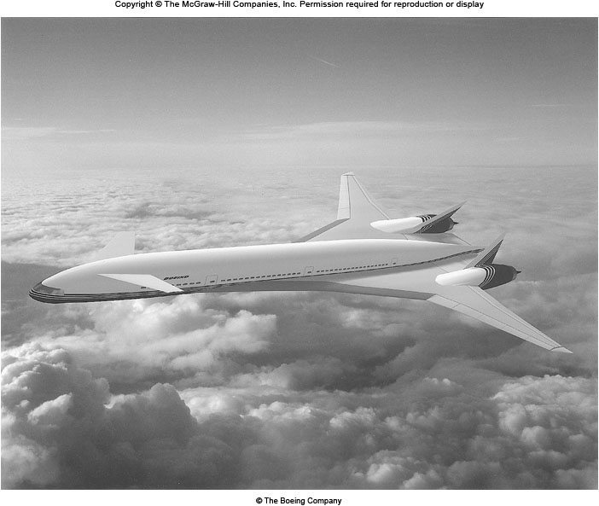
Hygh-Speed Civil Transport – Hyper-X
https://www.youtube.com/watch?v=6K_rzuSuqIg
https://www.youtube.com/watch?v=IFcS2RTA23w
https://www.youtube.com/watch?v=KNasb3-BFP8&ebc=ANyPxKr0Hi8Rq9phxUWe_5kCLA-nI4xd9hMEua3WOs5m5-lEM9HBQ7e10zLTAQuLc_cwTrNjiBTEEYDKvoizWzq1UdwW5JhdFg
High Tempt.: 1800 °C
High Speed: Mach 12-25 1225 km/h/Mach
New Materials: Ceramic-matrix composites, Intermetallic compounds, Superalloys
Fig. 1.1 Hyper-X at Mach 7 (The Boeing Co.)

Slide 13
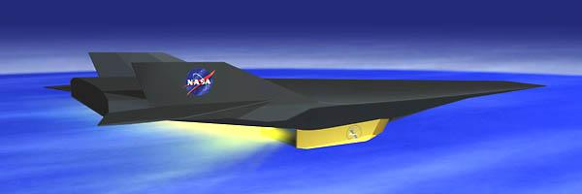
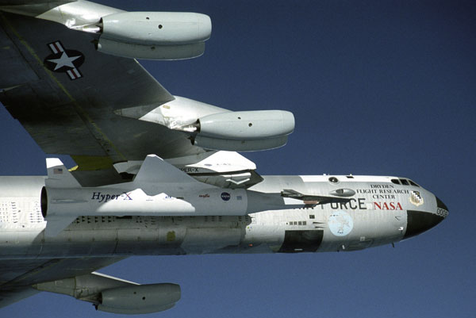
Hygh-Speed Civil Transport – Hyper-X
https://www.google.com.tw/search?q=hyper+x&safe=off&biw=1600&bih=765&tbm=isch&tbo=u&source=univ&sa=X&ved=0ahUKEwieuuqK7aHLAhUMlJQKHTfFCJsQsAQIRQ&dpr=1#imgdii=dNP2mnJOw_ky_M%3A%3BdNP2mnJOw_ky_M%3A%3By8vjU04SYIIHCM%3A&imgrc=dNP2mnJOw_ky_M%3A

Slide 14
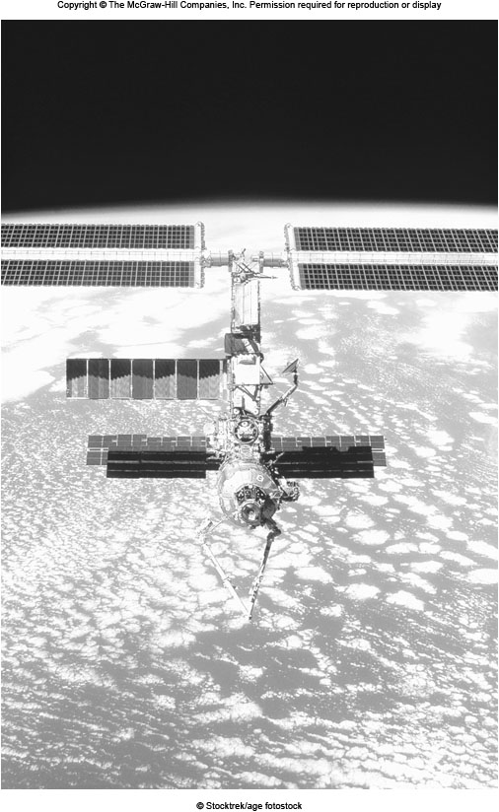
The International Space Station
Space exploration: International Space Station (ISS), Mars Exploration Rover (MER).
ISS: Speed: 27,000 km/h, Light weight, Impact of tiny meteoroids and man-made debris, Massive stresses at launch.
MER: Extremely low tempt.: −96°C
Push the limits of material selection in the complex systems.

Slide 15
Materials Usage and Engineering Designs
No one can predict the long-term future advances in material design and usage. Computers become a common household item. Will the space travel be commercialized?
Jet engine to operate more effectively.
Electronic devices can operate faster and at higher tempt.
Lighter aerospace vehicles.
Highly corrosion-resistant chemicals tank.
Smart micro-sensors and micro-actuators.
Nanomaterials: carbon nanotubes, graphene…
Engineers should have some basic and applied knowledge of engineering materials so that they will be able to do their works more effectively when using them.

Slide 16

Materials Science and Engineering
Materials science deals with basic knowledge about the internal structure, properties and processing of materials.
Materials engineering deals with the application of knowledge gained by materials science to convert materials to products.
Materials Science and
Engineering
Materials Science
Materials Engineering
Basic Knowledge
of Materials
Resultant Knowledge
of Structure, Properties, Processing, and Performance of Engineering Materials
Applied
Knowledge
of Materials
Fig. 1.3 Materials knowledge spectrum

Slide 17
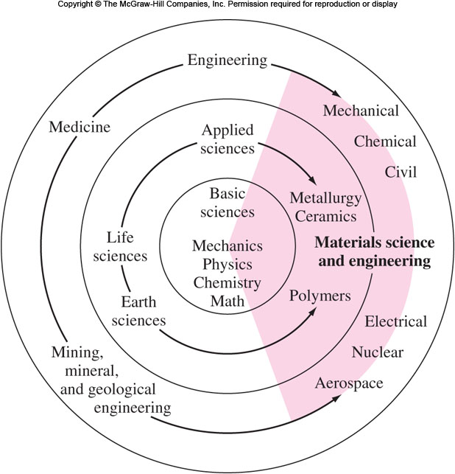
MSE form a Bridge of Knowledge
Three-ringed diagram: Basic sciences: Inner, Various engineering disciplines: Outermost, Applied science: Middle
Materials science engineering is shown to form a bridge of knowledge from the basic sciences to the engineering disciplines.

Slide 18
Types of Materials
Types of materials: Metallic, Polymeric, Ceramic, Composite, and Electronic Materials.
Metallic materials: Ferrous and Nonferrous
Composed of one or more metallic elements; may also contain nonmetallic elements.
Iron, Copper, Aluminum; Carbon, Oxygen, Nitrogen.
Inorganic and have crystalline structure.
Good thermal and electric conductors.
Strong, ductile.
Ferrous Metals: Steels, Cast iron 鋼鐵
Nonferrous Metals: Aluminum, Copper, Zinc, Magnesium, Titanium, and Nickel. 非鐵金屬

Slide 19
Metallic Materials
Metals in their alloyed and pure forms are used in numerous industries.
U.S. production of basic metals ⇔ U.S. economy
The existing alloys may be improved by better chemistry, composition control, and processing techniques.
Superalloys:
1961: Ni-base, Fe-Ni-Co-base superalloys. They improved performance at elevated tempt. 540 °C.
1980: Columnar grain and single crystal casting Ni-base alloys.
1990s: Single crystal superalloys were standard and significantly improved the efficiency of the aircraft engines.

Slide 20
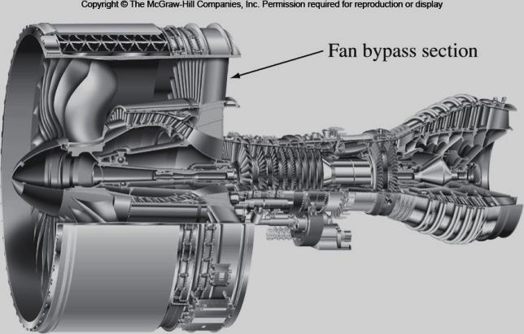
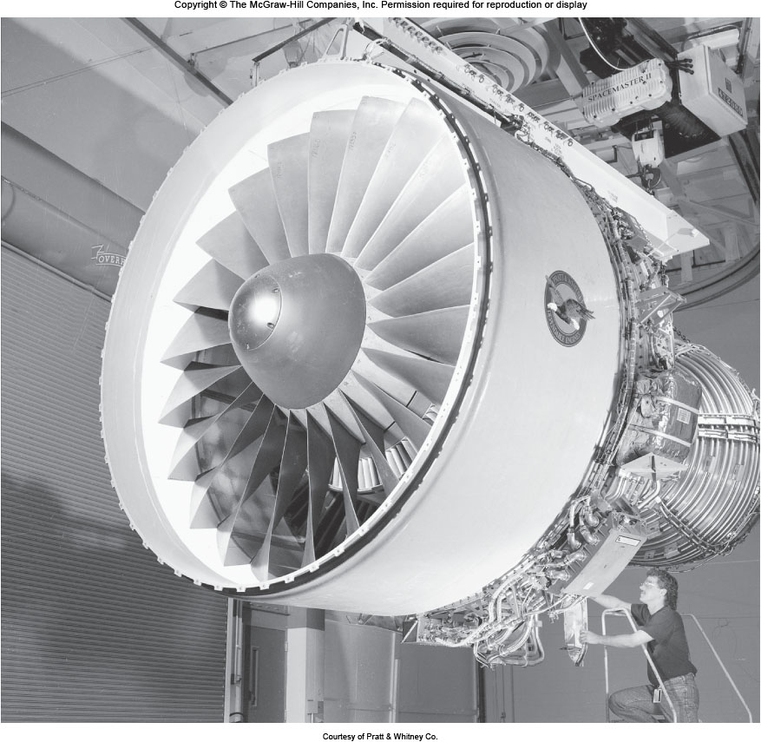
Aircraft Turbine Engine (PW 4000)
Fig. 1.5 The aircraft turbine engine (PW 4000).
Fig. 1.6 Cutaway of the PW 4000 284.48-cm (112 in.) gas turbine engine, showing fan bypass section.

Slide 21
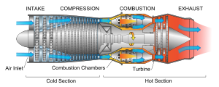
燃氣渦輪噴射發動機的圖示
http://zh.wikipedia.org/wiki/%E7%87%83%E6%B0%A3%E6%B8%A6%E8%BC%AA%E7%99%BC%E5%8B%95%E6%A9%9F

Slide 22
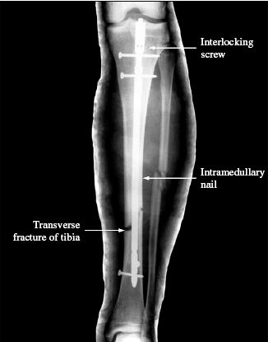
Metallic Materials
Biomedical Metals:
Orthopedic implants, heart valves, stents, fixations.整型
Titanium alloys, stainless steels, cobalt-base alloys.
High strength, stiffness, and biocompatibility.生物相容性
New Processing Techniques:
Hot isostatic pressing, isothermal forging ⇒ fatigue life ↑.
Powder metallurgy: lower finished product cost.
髓內釘
Fig. 17.16 髓內釘與螺絲固定斷掉的脛骨

Slide 23
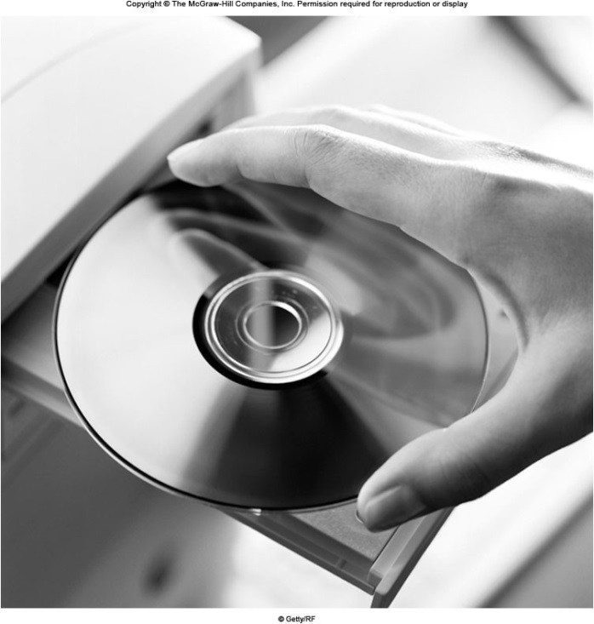
Polymeric (Plastic) Materials
Polymeric (Plastic) Materials
Organic giant molecules and mostly noncrystalline.非晶
Some are mixtures of crystalline and noncrystalline regions.
Poor conductors of electricity and hence used as insulators.
Strength and ductility vary greatly.
Low densities and decomposition temperatures.
Applications: Appliances, DVDs, Fabrics etc.
Engineering plastics: such as nylon,
Polymer-polymer mixtures (blends摻合物): elastomers blended with other plastics, acrylic coatings blended with various fibers and fillers.

Slide 24
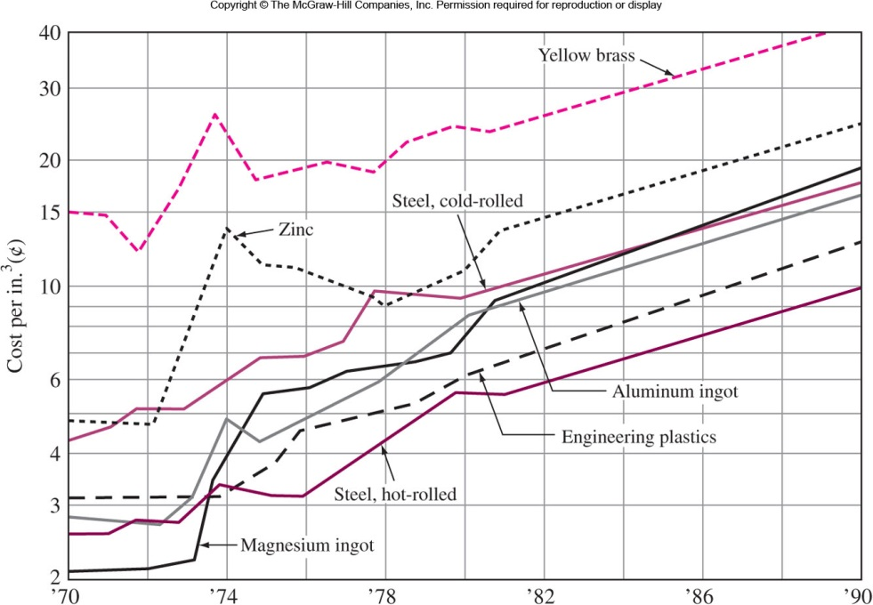
Costs: Engineering Plastics vs. Metals

Slide 25
Ceramic Materials
Metallic and nonmetallic elements are chemically bonded together. Light weight.
Inorganic but can be either crystalline, noncrystalline or mixture of both.
High hardness, strength and wear resistance. But brittle.
Very good insulator. Hence used for furnace lining for heat treating and melting metals.
Advanced ceramics (Fine ceramics): Higher strength, better wear and corrosion resistance, and enhanced thermal shock resistance. Include alumina, silicon nitride and silicon carbide. 尖端陶瓷、精密陶瓷

Slide 26
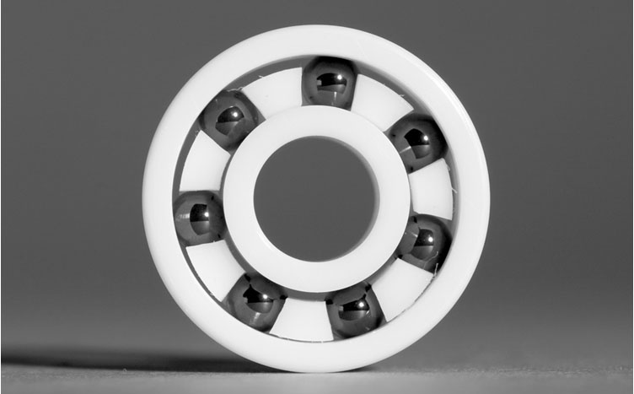
Applications of Ceramic Materials
Traditional Ceramics: Made from clay, silica, feldspar. Glasses, bricks, tiles, and electrical porcelain. 長石
Advanced Ceramics: Cutting tools (Al₂O₃, Si₃N₄), Substrates for electronic devices (Al₂O₃, AlN), Heat element for high temperature furnace (SiC).
Application Areas: metal manufacturing, automobile, aerospace, biomedical.
Drawbacks: Brittle, difficult to process and expensive.
Fig. 1.10 High performance ceramic ball bearings and races. TiN/CN

Slide 27
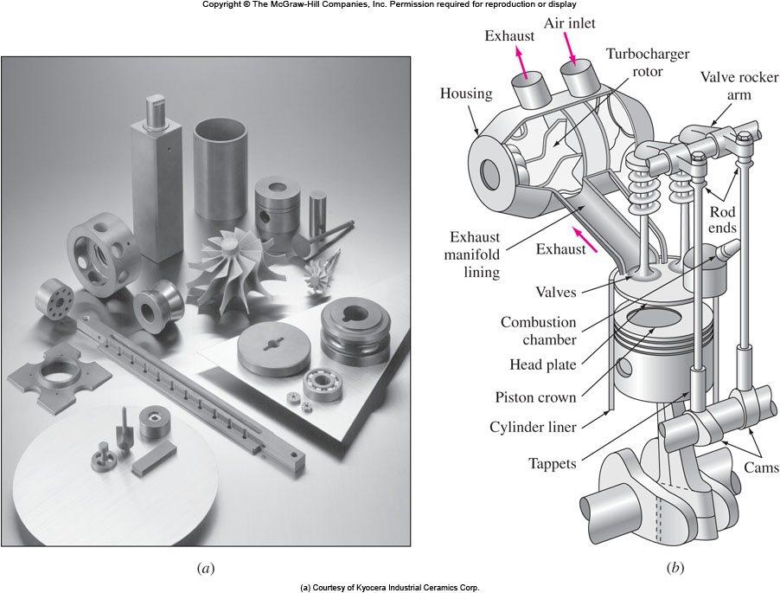
Ceramic Parts for Advanced Engine
Si₃N₄, Al₂O₃

Slide 28
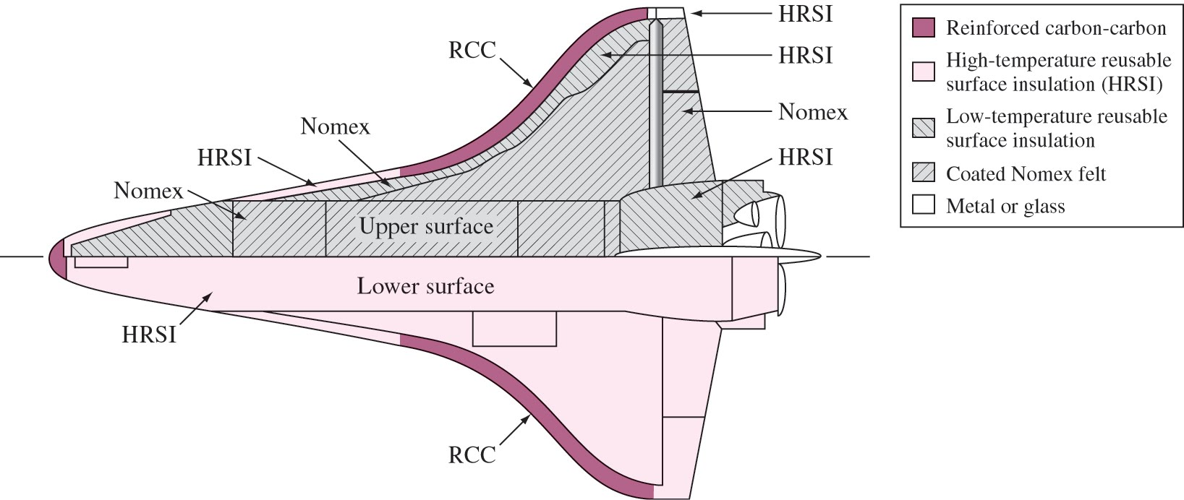
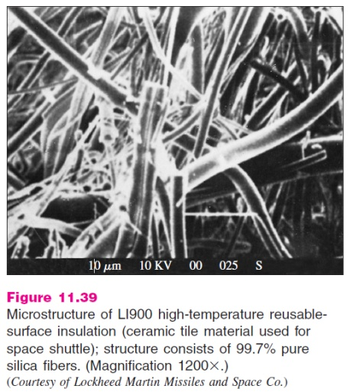
Space Shuttle Thermal Protection Systems
70% of the surface is protected by 24,000 ceramic tiles made from a silica-fiber compound.
HRSI: High-temperature Reusable Surface Insulation.
Density: 0.141 g/cm³; Can withstand tempt.: 1260 °C.

Slide 29
Composite Materials
Mixture of two or more materials.
Consists of a filler material (reinforcement) and a binding material (matrix).
Materials only bond, will not dissolve in each other.
Reinforcements can be metals, ceramic or polymer.
Fibers: carbon, glass, aramid, stainless steel, silicon carbide.
Particles: alumina, silicon carbide.
Matrix can be metals, ceramic or polymer. PMC (polyester, epoxy), MMC (aluminum, cobalt), CMC (alumina, silicon nitride).
Advantages: High strength and stiffness-to-weight ratio.
Applications: Aerospace, automobile, civil structural, and sports equipment industries.

Slide 30
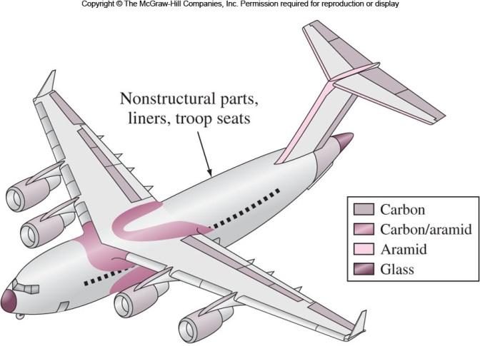
Fig. 1.11 Overview of the variety of composite parts used in the Air Force’s C-17 transport. This airplane has a wingspan of 50 m and uses 6800 kg of advanced composites.

Slide 31
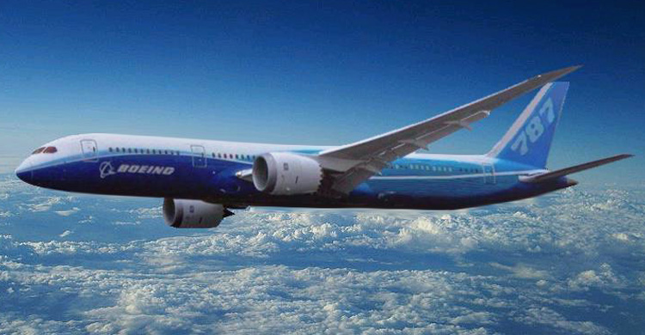
MF Ashby, Materials Selection in Mechanical Design, 4e, Elsevier, (2011) Fig. 1.6.
FIGURE 1.6
Aircraft: the Wright biplane of 1903, the Douglas DC3 of 1935, and the Boeing 787 Dreamliner of 2010. 波音787採用80vol%的複材，聲稱每個座位減輕30%的重量
‹#›
http://upload.wikimedia.org/wikipedia/commons/5/5f/Dreamliner_render_787-9.JPG

Slide 32
機型 | 787-3 | 787-8 | 787-9
機師數 | 2
座位數 | 290 ~ 330 | 210 ~ 250 | 250 ~ 290
長度 | 186英尺（57公尺） |  | 206英尺（63公尺）
翼展 | 170英尺（52公尺） | 197英尺（60公尺） | 208英尺（63公尺）
後掠翼 | 32.2°
高度 | 16.92 m
機身高 | 5.91 m
機身宽 | 5.75 m
座舱宽 | 5.49 m
载货容量 | 4,400 ft³（124.6 m³）28 LD3 |  | 5,400 ft³（152.9 m³）36 LD3
空重 | 101,151 kg | 109,769 kg | 115,213 kg
最大起飛重量 | 165,108 kg | 219,539 kg | 244,940 kg
巡航速率 | 0.81馬赫（Mach）（903 km/h, 561英里（mph），487節（knots），於40,000英呎高空/12.19 km）
最高巡航速率 | 0.85馬赫（945 km/h，587英里，51節，於40,000英尺高空／12.19 km）
满载航距 | （4,650 ~ 5,650 km） | （14,200 ~ 15,200 km） | （14,800 ~ 15,750 km）
最大燃油容量 | 126,918 L |  | 138,898 L
實用高限 | 43,000英尺（13,106.4公尺）
發動機 （x2） | 通用電器（GE / General Electric）GEnx 或 劳斯萊斯（Rolls-Royce Trent）Trent 1000
最大發動機推力 | 53000 lbf（235.8 kN） | 64000 lbf（284.7 kN） | 70000 lbf（311.4 kN）
http://zh.wikipedia.org/wiki/%E6%B3%A2%E9%9F%B3787

Slide 33
Electronic Materials
Not major by volume but very important.
Silicon is the most important electronic material.
Its electrical characteristics are changed by adding impurities.
A tremendous growth since 1970 and then.
In 1998 , the point-to-point resolution on a silicon chip was 180 nm and the diameter of the silicon wafer used was 300 mm (~165 kg/m). In 2014, the point-to-point resolution on a silicon chip was 20 nm.
Aluminum replaced by copper for interconnects because of the higher melting point and conductivity of copper.
Applications: Computers, cell phone, communication satellites, robots, factories of the future etc.

Slide 34
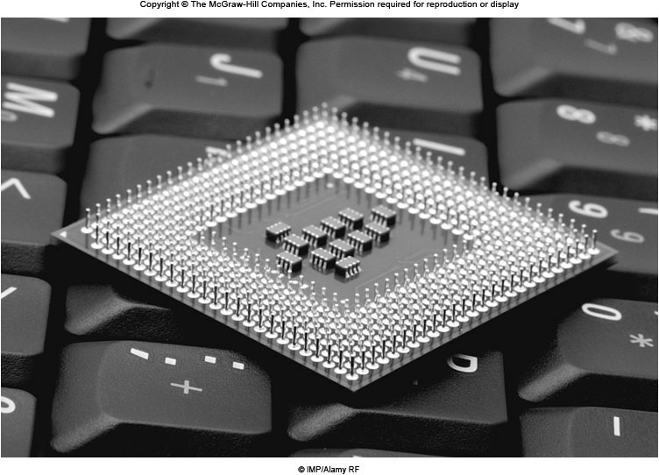
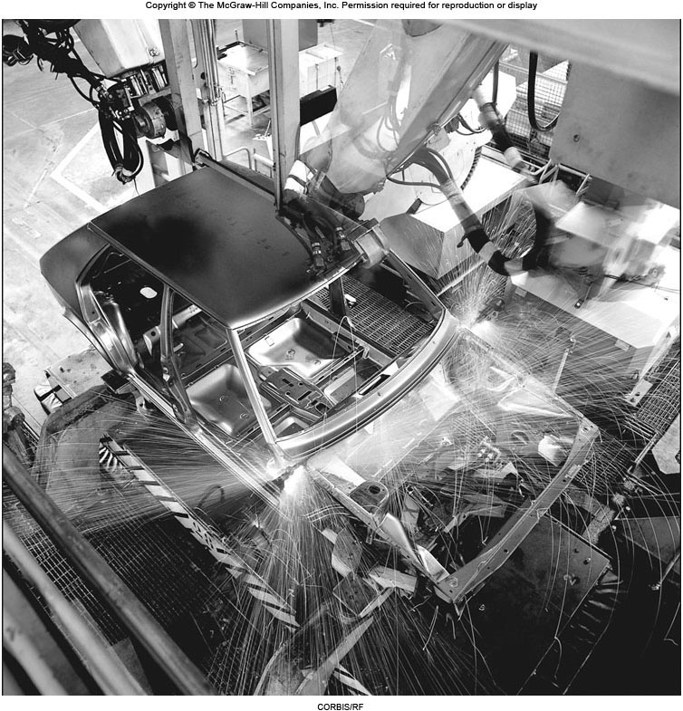
Applications of Electronic Materials
Fig. 1.12 Intel’s Pentium II microprocessor has a multitude outlets. This chip is about 1.9 cm square. 480 pins.
Fig. 1.13 Robotic arms welding car parts.

Slide 35
Competition Among Materials
Materials compete with each other.
Over a period of time usage of different materials changes depending on cost and performance.
A breakthrough in technology ⇒ cost down substantially ⇒ material replacement.
A new materials with special properties ⇒ material replacement.
Aluminum and polymers show an outstanding increase in production since 1930. This trend is also exists in auto.
The materials used must also meet performance specification: Expensive superalloys in jet engine.

Slide 36
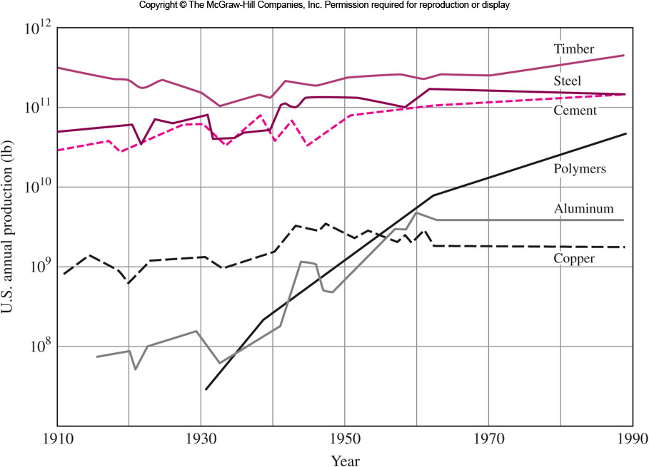
Competition Among Materials
Fig. 1.14 Competition of six major materials in the United States on a weigh basis. Aluminum and polymers rise rapidly.

Slide 37
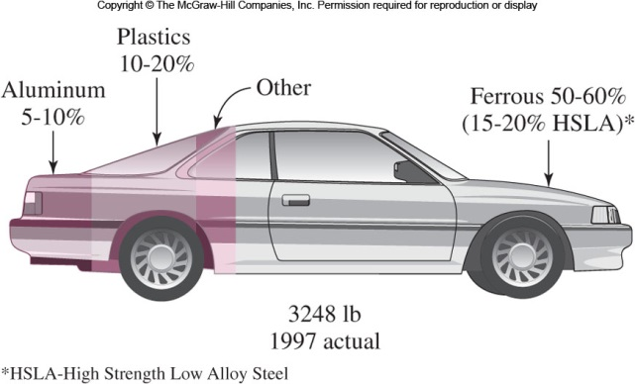
Competition Among Materials
Fig. 1.15 Breakdown of weight percentages of major materials in the average 1985 U.S. automobile..

Slide 38
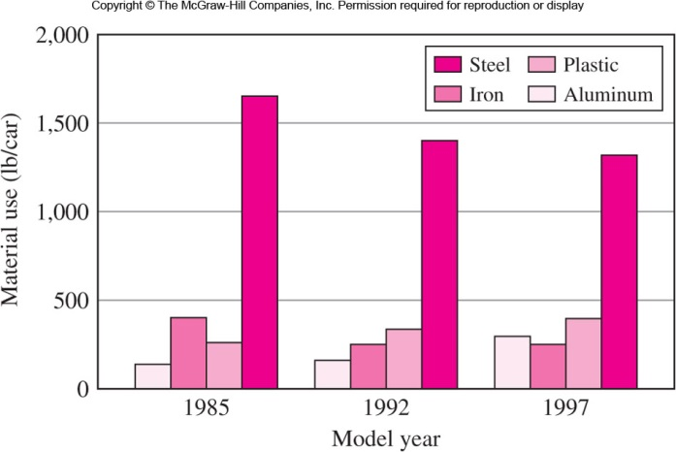
Competition Among Materials
Fig. 1.16 Predictions and use of materials in U.S. automobile.

Slide 39
Recent Advances and Future Trends
Smart Materials
React to environment stimuli: temperature, stress, light, humidity, and EM fields.
Change their properties by sensing external stimulus.
Consist of sensors and actuators: Some smart materials change or produce color when exposed to changes in temperature, light intensity, or an electric current.感測器與致動器
Shape-memory alloys
Phenomenon: Once strained, revert back to their original shape upon an increase in temperature above T_{c}. Nitonol.
Vascular stent血管支架: Supporting weakened artery walls or expanding narrowed arteries (Fig. 1.17). Instead of a stainless steel tube that is expanded using a balloon.
Coffeepot thermostats, Arch wires in orthodontics牙齒矯正線.

Slide 40
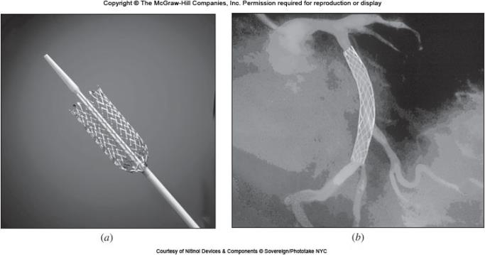
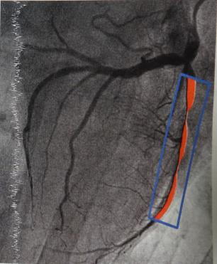
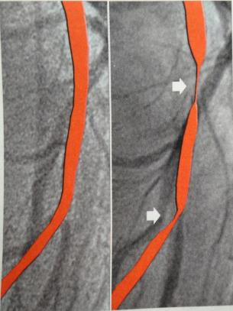
Ni-Ti 形狀記憶合金做的心血管支架(stent)
Fig. 1.17 Shape-memory alloys used as a stent.
李家維，命懸一念間，科學人，2014年2月，第6頁。

Slide 41
Recent Advances and Future Trends
Piezoelectric materials
Produce an electric field when exposed to a mechanical force, and versa.
Can used to sense and reduce undesirable vibration.
Ultrasonic vibration cleaner, Sonar聲納.
Microelectromechanical systems (MEMs)
At micrometer size scale that use smart materials and devices to sense, communicate, and actuate.
Original MEMs were known as a micromachines on a chip.
Today, MEMs is extended to any miniaturized device.
Micropumps, locking systems, motors, mirrors and sensors.
MEMs are used in automobile airbags to sense both deceleration and the size of the person sitting in the car and to deploy the airbag at a proper speed.

Slide 42
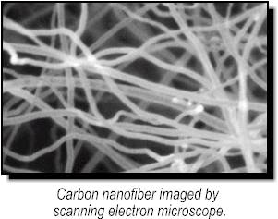
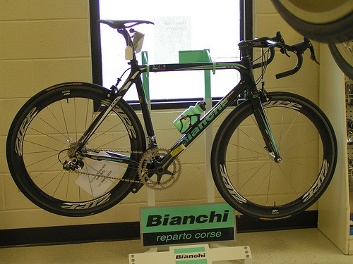
Recent Advances and Future Trends
Nanomaterials
Smaller than 100 nm (a characteristic length scale).
Very hard and strong: Nanostructural pure copper has a yield strength six times that of coarse-grained copper.
New tools to characteristic and new methods to synthesis.
Nano-zirconia implants allow for bone to grow into pores.
Carbon nanofiber reinforced plastic: very light and strong.

Slide 43
Case Study – Material Selection
Problem: Select suitable material for bicycle frame and fork.
Steel and
alloys
Wood
Carbon fiber
Reinforced
plastic
Aluminum
alloys
Ti and Mg
alloys
Low cost but
Heavy. Less
corrosion
resistance
Light and
strong. But
cannot be
shaped
Very light and
strong. No
corrosion.
Very expensive
Light, moderately
Strong. Corrosion
Resistance.
Expensive
Slightly better
than Al
alloys. But much
expensive
Cost important? Select steel, Al alloys
Properties important? Select CFRP

Slide 44
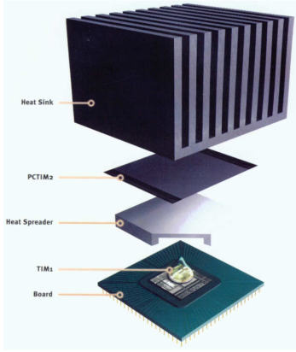
Diamond/Cu Composites Fabricated
by Pressureless Liquid Phase Sintering
Volume
Power
Packaging
density
operating
Waste heat
Thermal management
materials
Failure of device
Thermal conductivity
CTE: 4-8 ppm/K

Slide 45
Experimental procedure
Selected material powders were mixed and compacted under 710 MPa for 10 min.
Pressureless liquid phase sintering in tube furnace with H₂ (100 sccm) gas flow under vacuum (1.8 torr) at 1373 K.
SEM
TC
Relative density
CTE
TEM
鍾志育，無壓燒結鑽石/銅鈦複材，清大材料系博士論文，2014年1月。

Slide 46
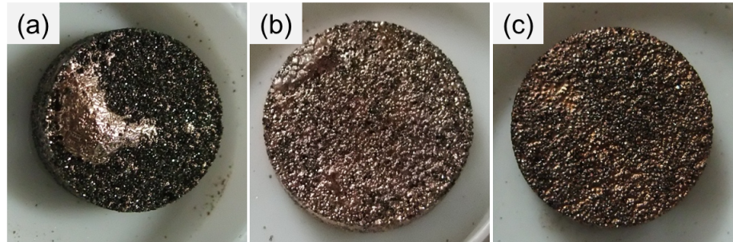
Effect of varying Ti content (50D, YK9E)
The surface images of the 50 vol% diamond composites with varying Ti additions in the Cu matrix: (a) 0.2 at% Ti, (b) 0.3 at% Ti and (c) 0.6 at% Ti.
0.3 at% addition
Integral-shape composites
鍾志育，無壓燒結鑽石/銅鈦複材，清大材料系博士論文，2014年1月。

Slide 47
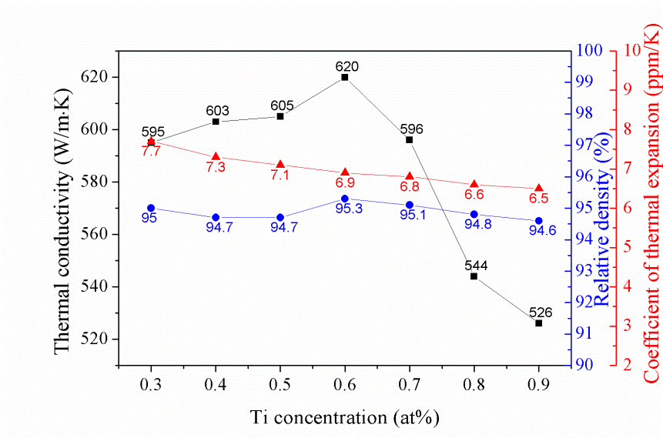
TC, RD and CTE versus Ti content (50D)
Wettaility
TiC
鍾志育，無壓燒結鑽石/銅鈦複材，清大材料系博士論文，2014年1月。

Slide 48
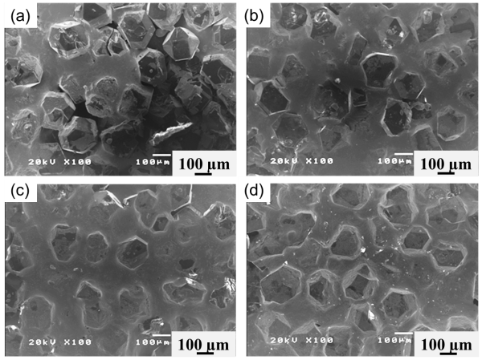
Microstructures of the Dia./Cu composites
Ti addition
Interfacial pores
Coverage rate on diamond surface
The surface SEM images of the 50 vol% diamond composites with varying Ti addition in the Cu matrix: (a) 0.3 at% Ti, (b) 0.4 at% Ti, (c) 0.6 at% Ti and (d) 0.9 at% Ti.
鍾志育，無壓燒結鑽石/銅鈦複材，清大材料系博士論文，2014年1月。

Slide 49
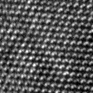
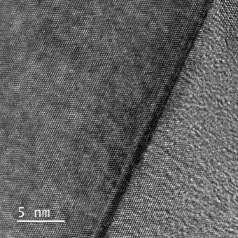
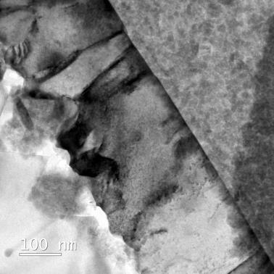
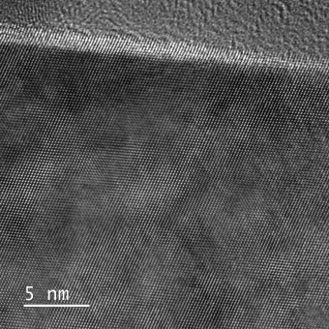
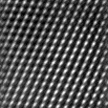
(002)
Interface between diamond and Cu-C groove structure
(111)
Diamond
C
TiC
Cu
(111)
(002)
Cu
C
(111)
(002)
Diamond
100 nm
Groove structure
Diamond
Groove structure is comprised of Cu
and amorphous C.
鍾志育，無壓燒結鑽石/銅鈦複材，清大材料系博士論文，2014年1月。

Slide 50
Compare with Theoretical TC
Samples | R_{TiC/diamond} (m²·K/W) | R_{TiC} (m²·K/W) | R_{Cu/TiC} (m²·K/W) | R_{k} (m²·K/W) | K_{p}^{eff} (m²·K/W)
50D_0.6Ti_30min | 5.2 × 10⁻¹⁰ | 1.4 × 10⁻⁸ | 1.4 × 10⁻¹⁰ | 1.5 × 10⁻⁸ | 1530
50D_0.6Ti_180min | 5.2 × 10⁻¹⁰ | 1.7 × 10⁻⁸ | 1.4 × 10⁻¹⁰ | 1.8 × 10⁻⁸ | 1480
50D_0.9Ti_30min | 5.2 × 10⁻¹⁰ | 4.8 × 10⁻⁸ | 1.4 × 10⁻¹⁰ | 4.9 × 10⁻⁸ | 1133
Samples | K_{c} (W/m·K) | K_{c-p} (W/m·K) | K_{exp} (W/m·K) | Deviation (%)
50D_0.6Ti_30min | 761 | 725 | 620 | −14
50D_0.6Ti_180min | 751 | 714 | 549 | −23
50D_0.9Ti_30min | 663 | 627 | 526 | −16
The experimental values are similar to the theoretical values.
鍾志育，無壓燒結鑽石/銅鈦複材，清大材料系博士論文，2014年1月。

